Slide 1
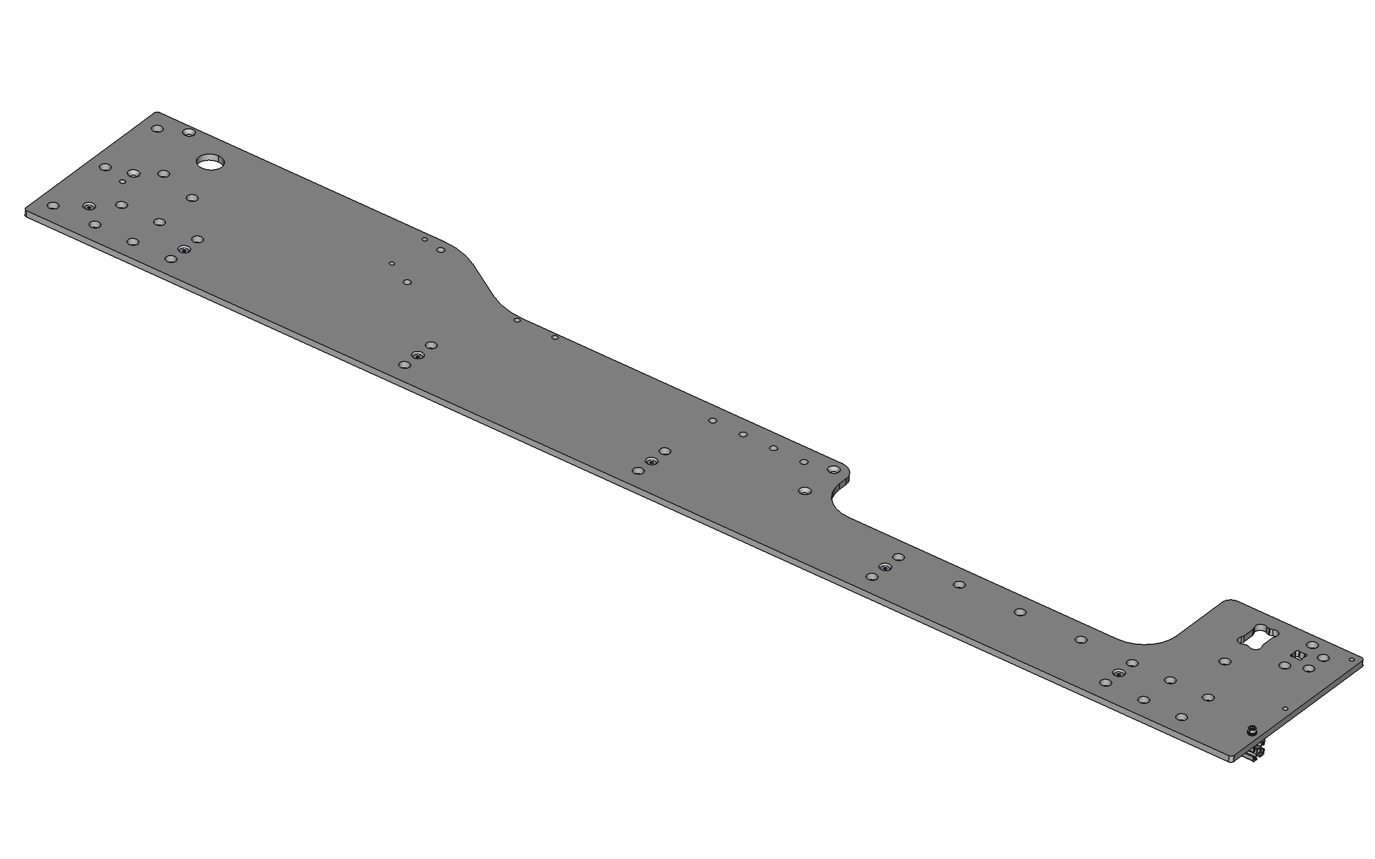
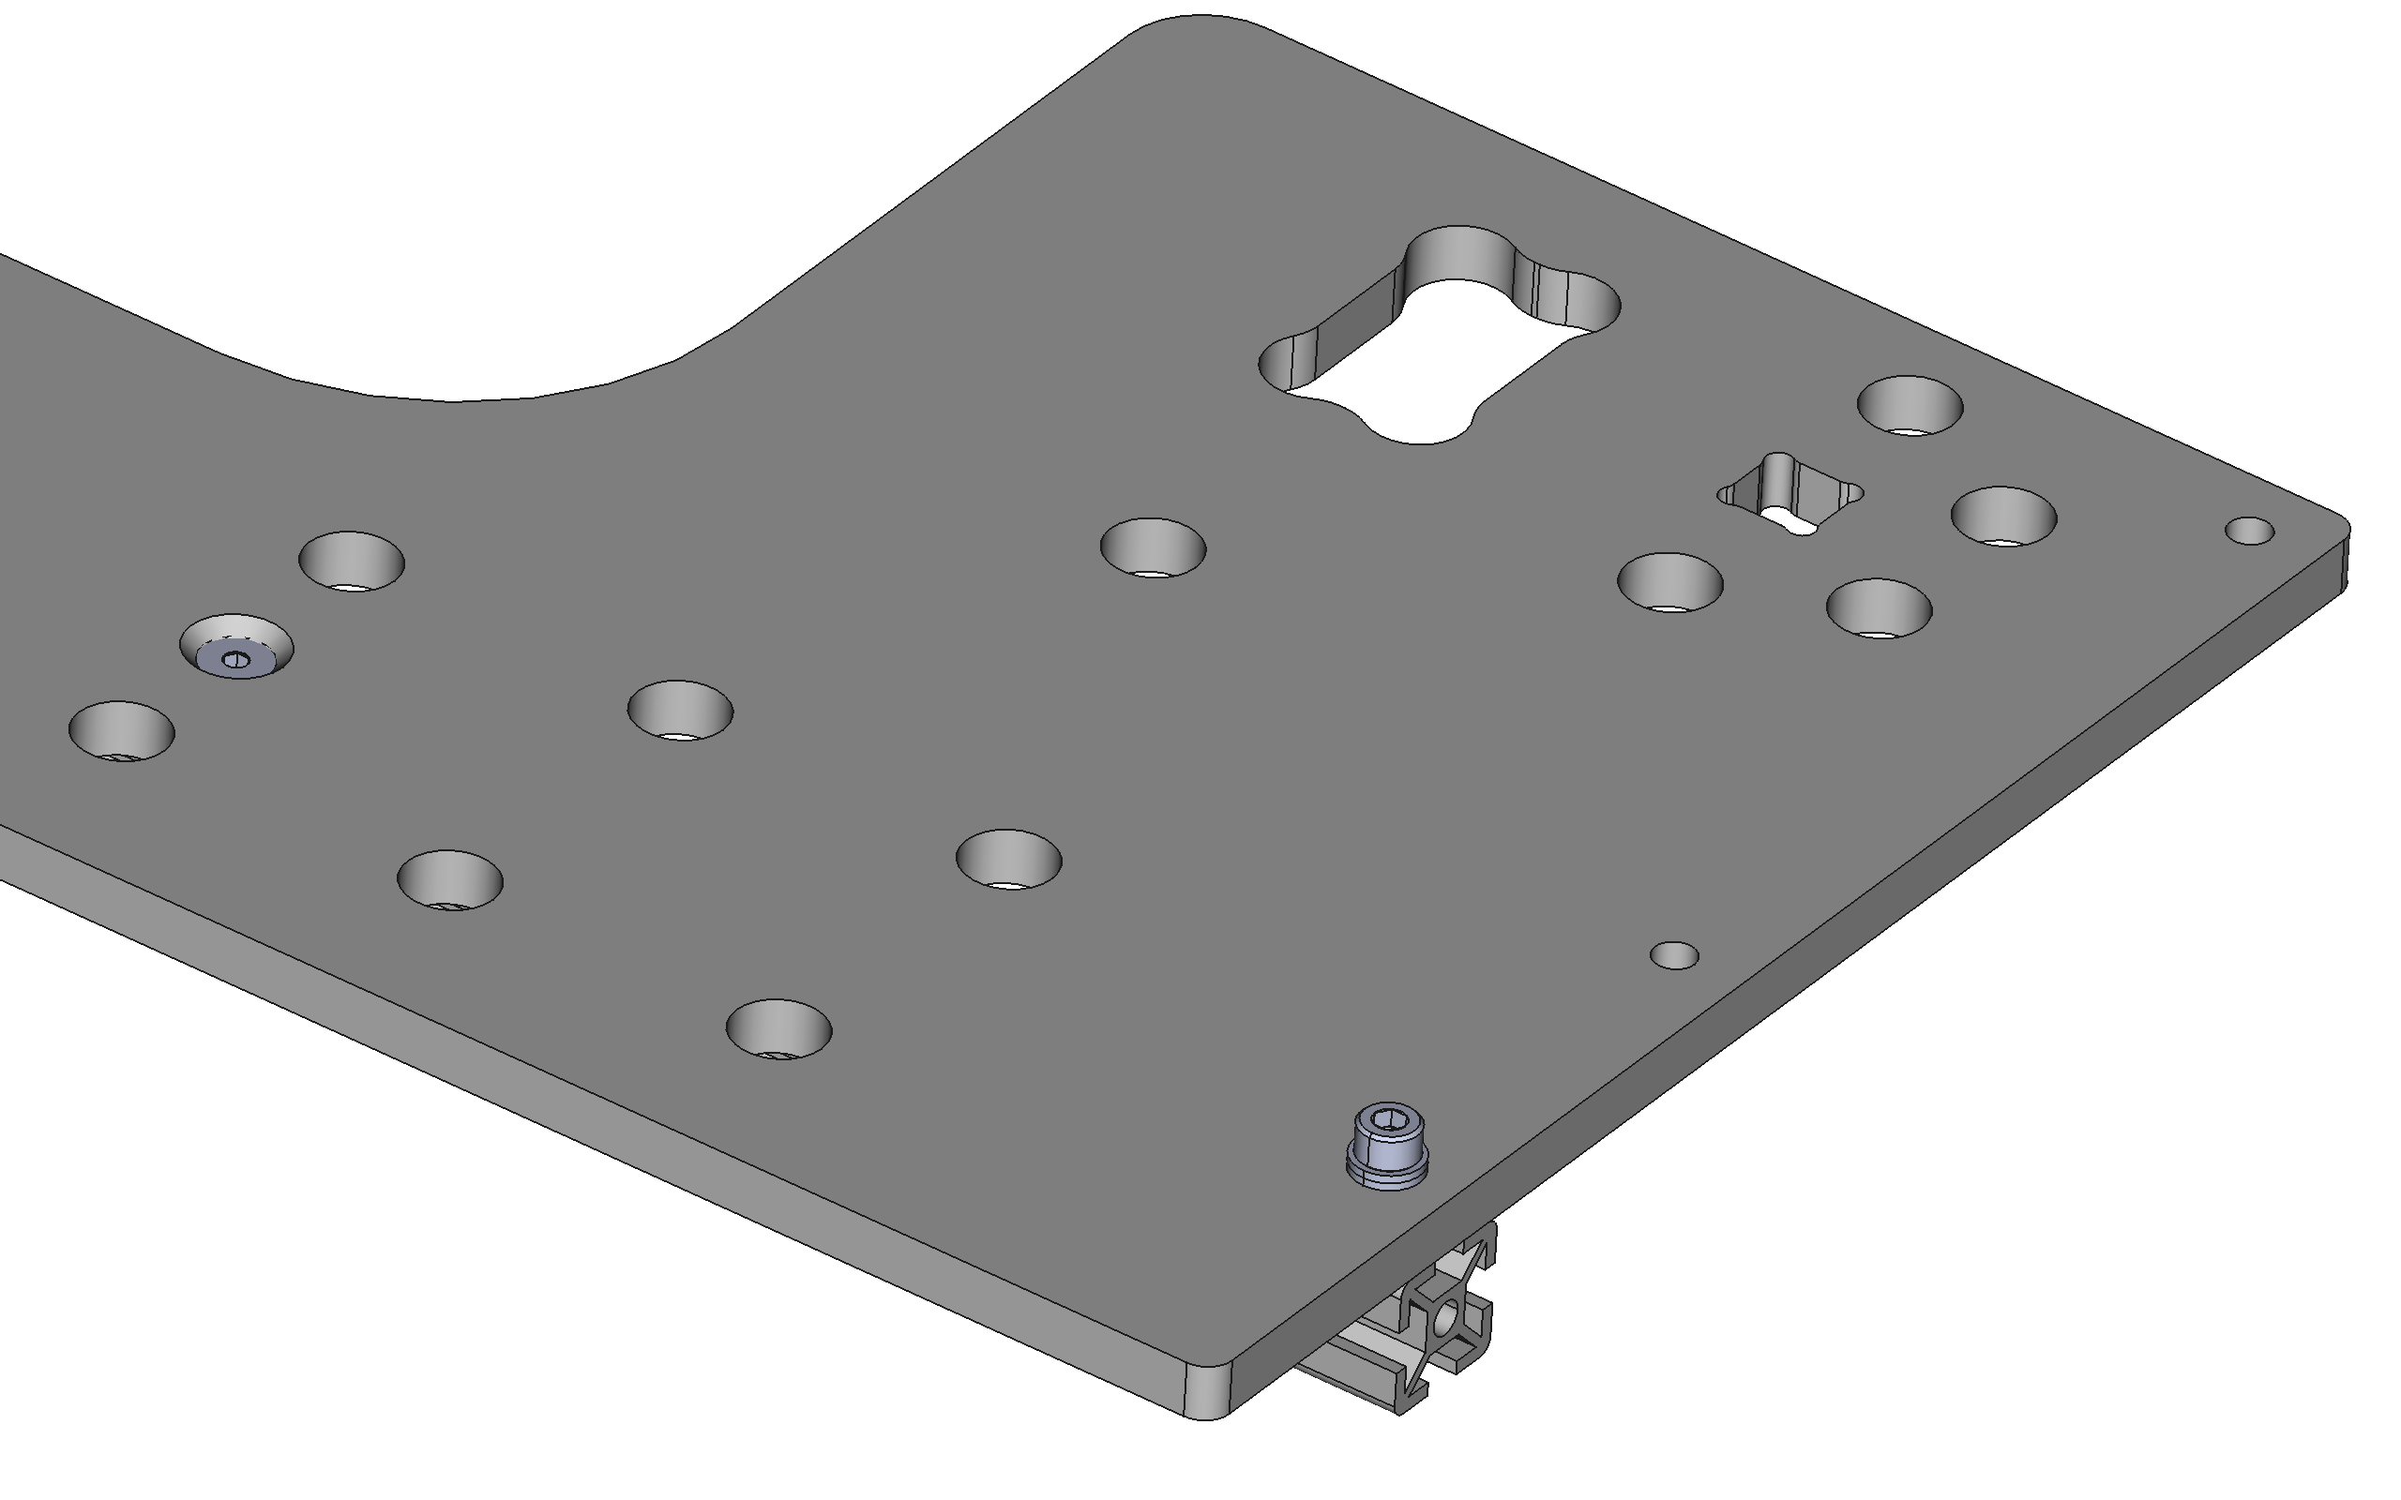
Rail end aligned with plate end

Slide 2
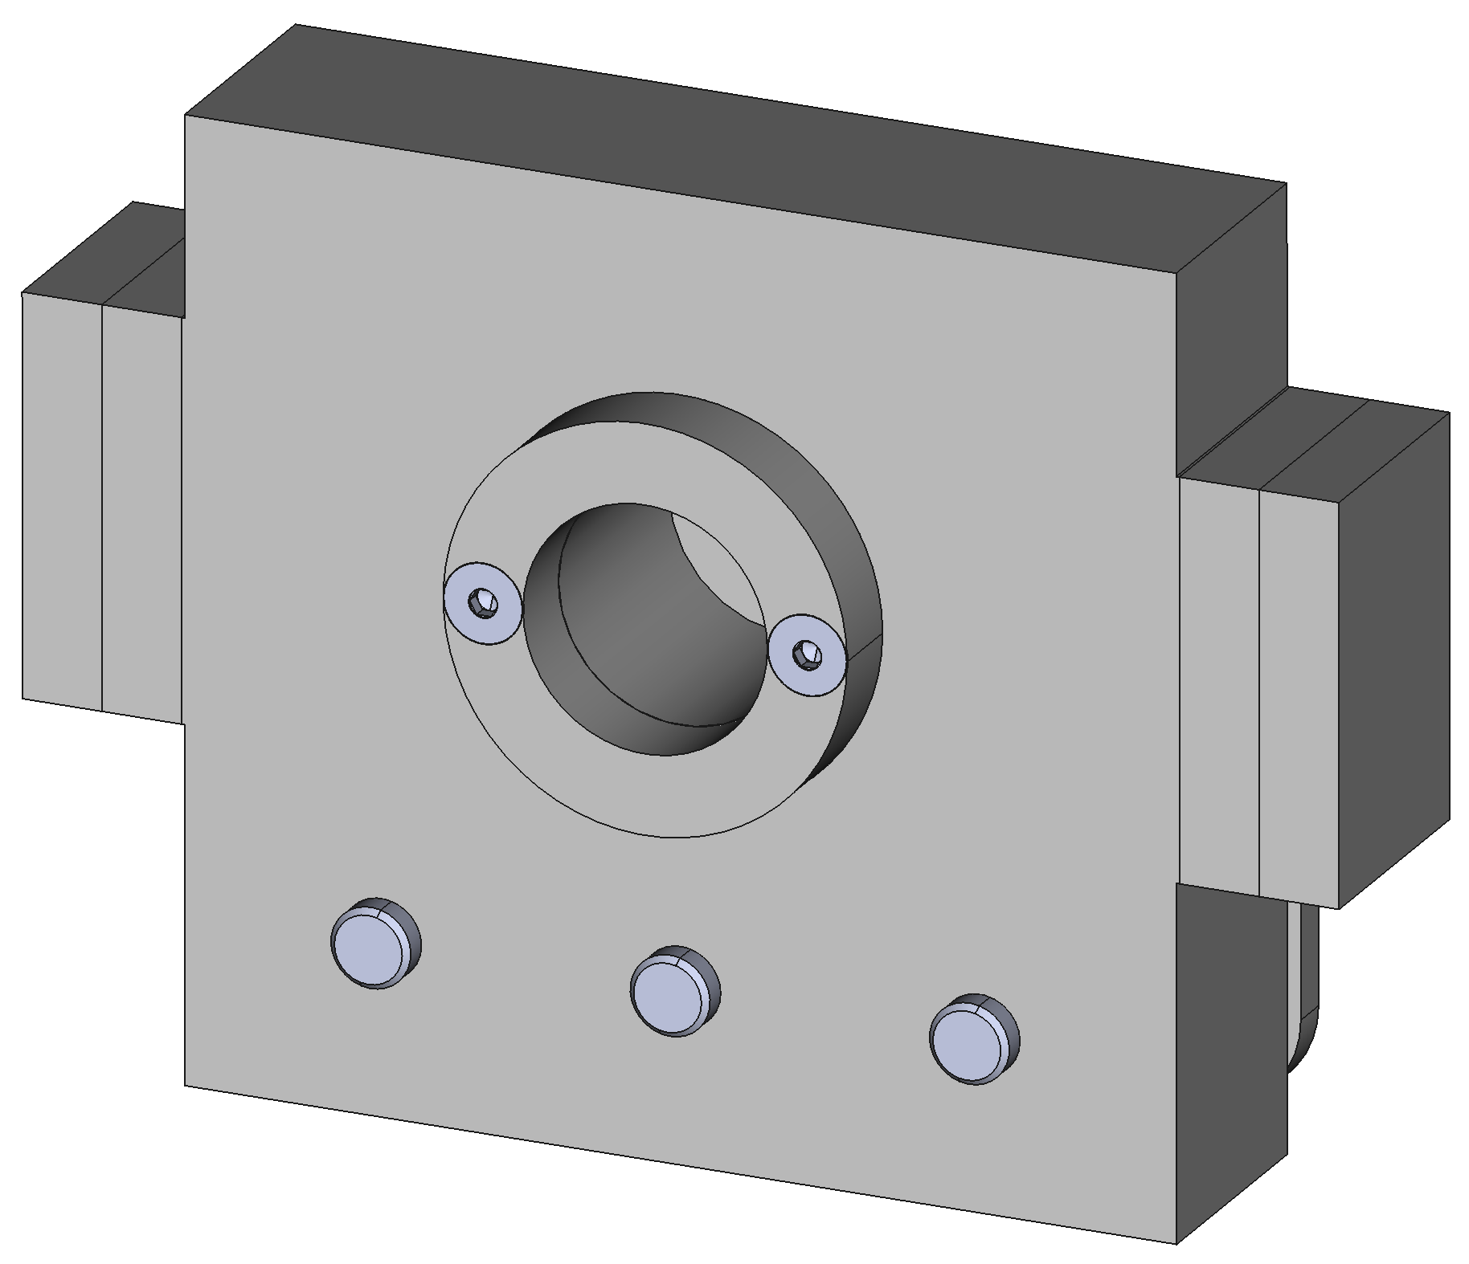
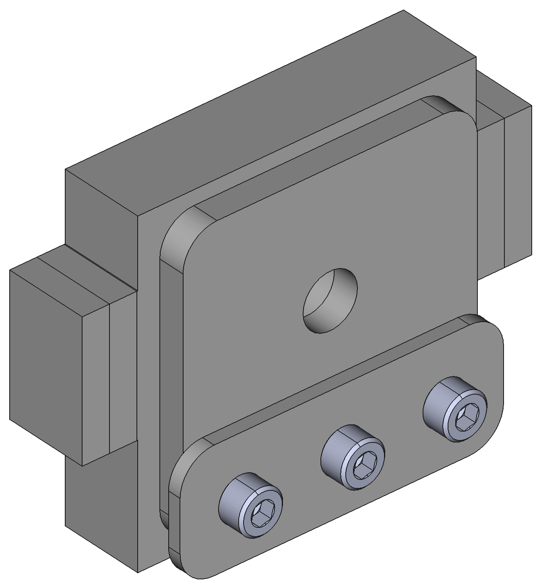
Mount centring ring with 2x M4x25mm countersunk head screws
Mount alignment and associated cap plate with 3x M8x40mm cap head screws

Slide 3
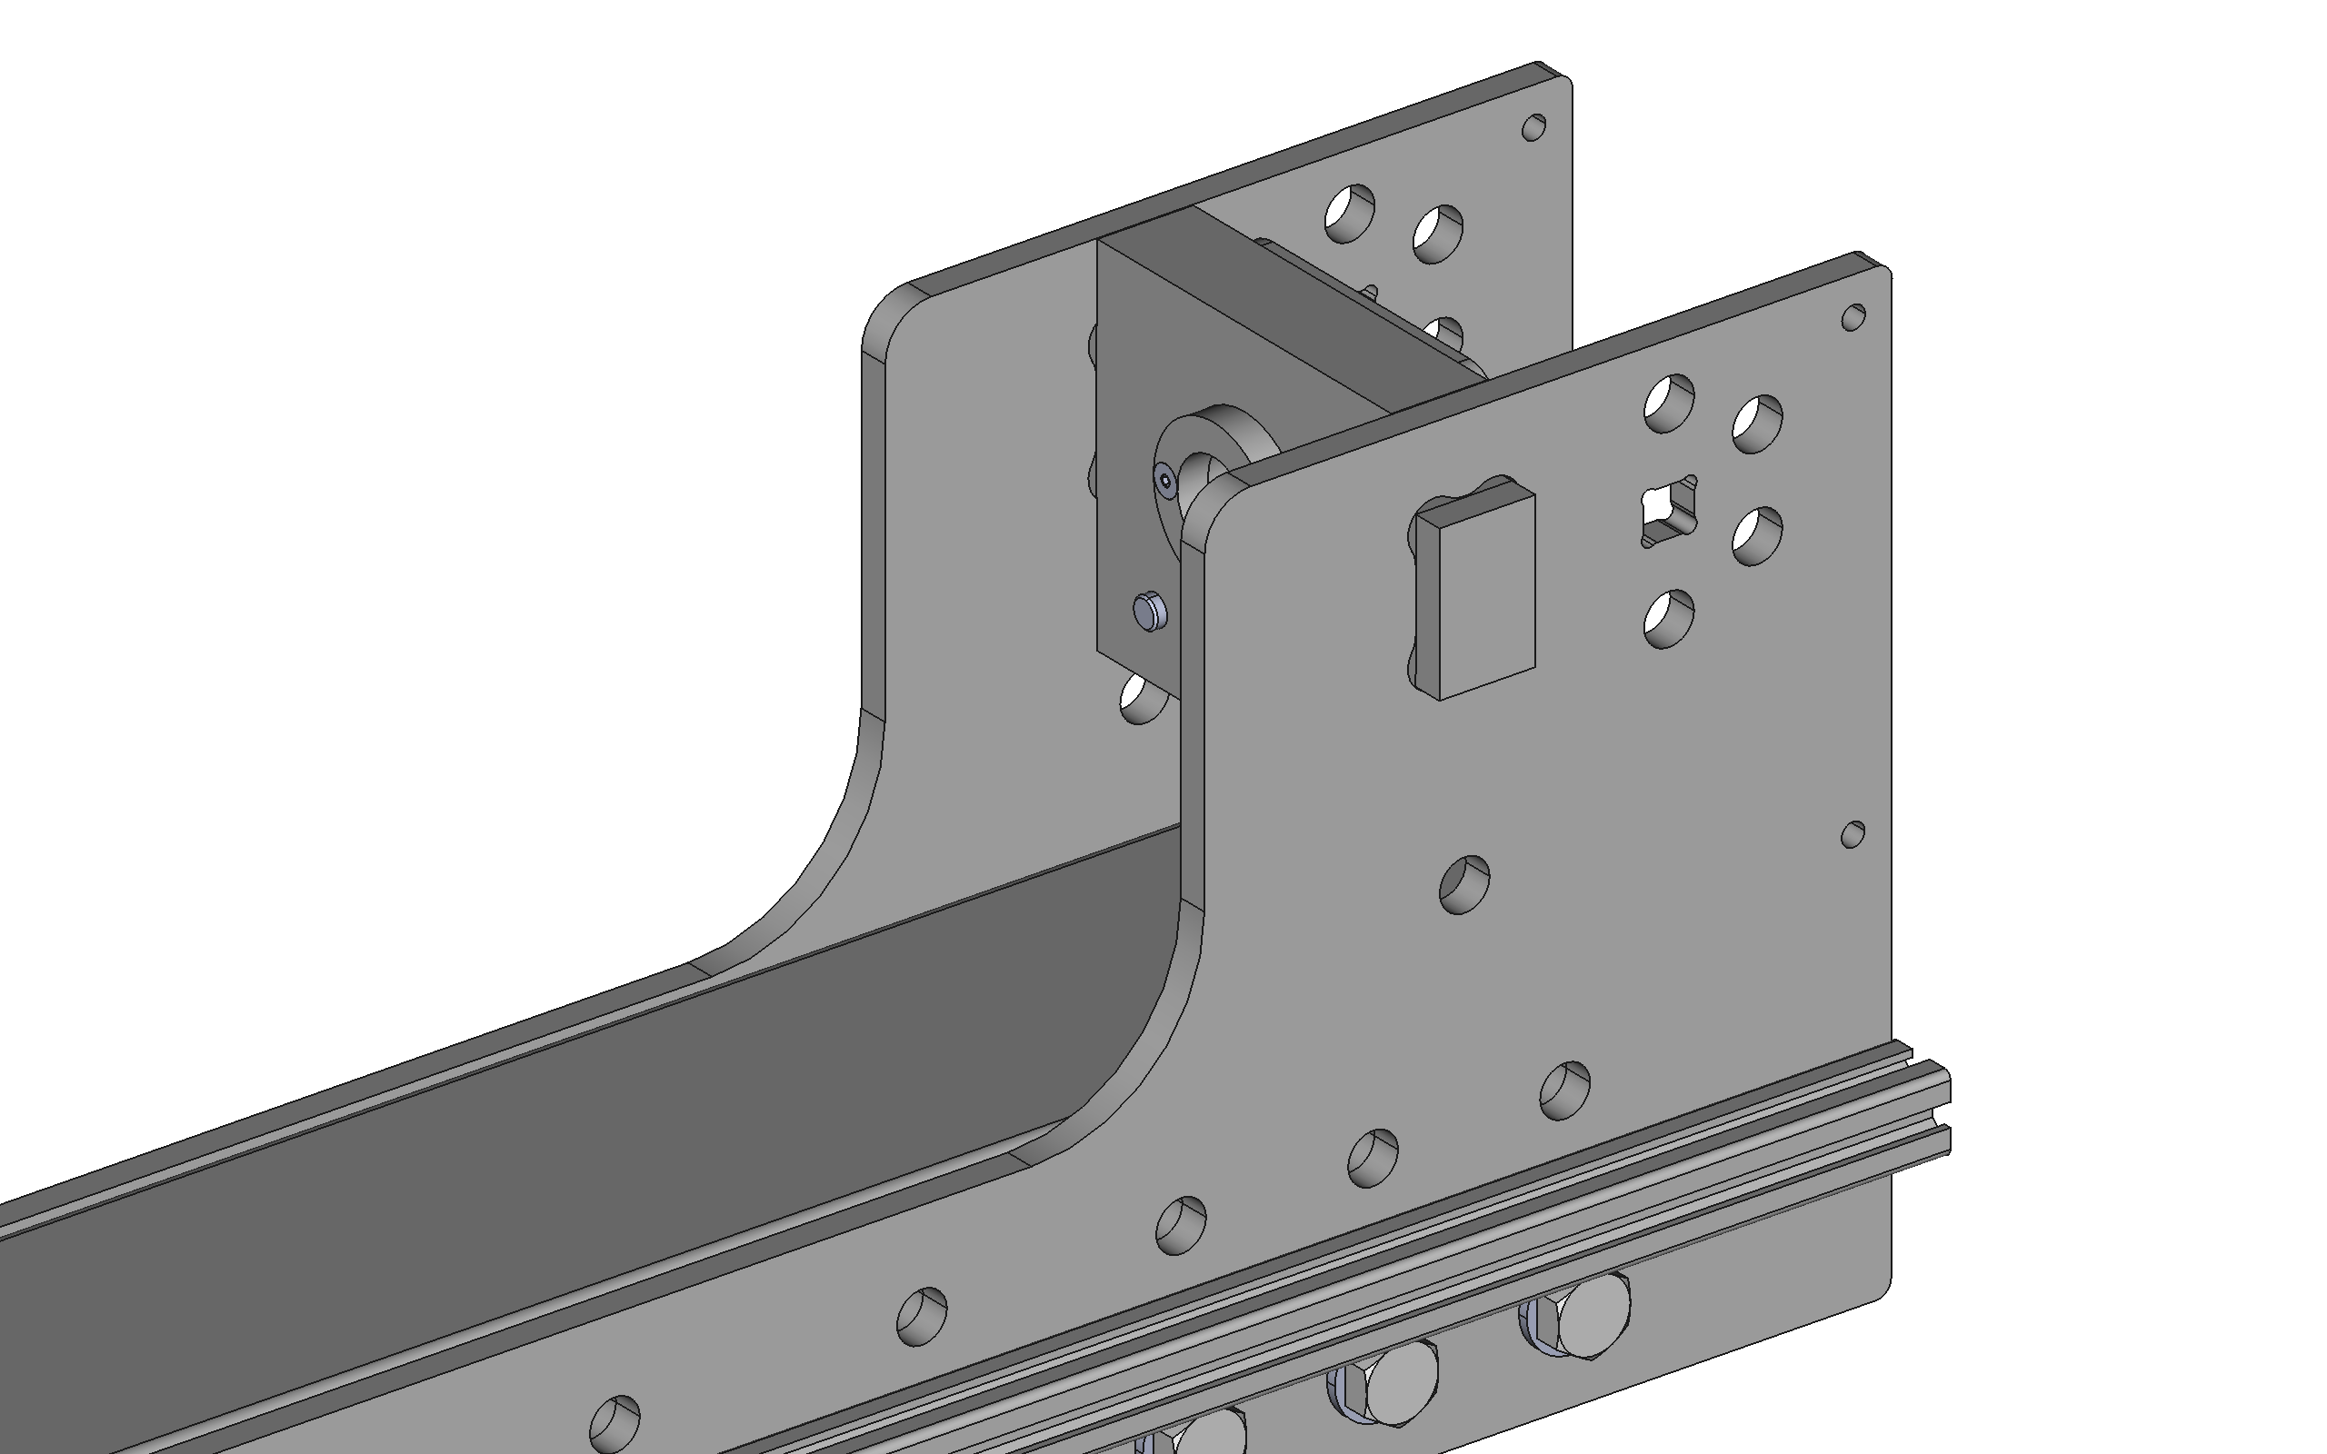
2. Cut and insert steel shims as necessary to correct alignment of tabbed end plate
1. Check perpendicularity of inside edge of tabbed end plate to instrument side panels

Slide 4
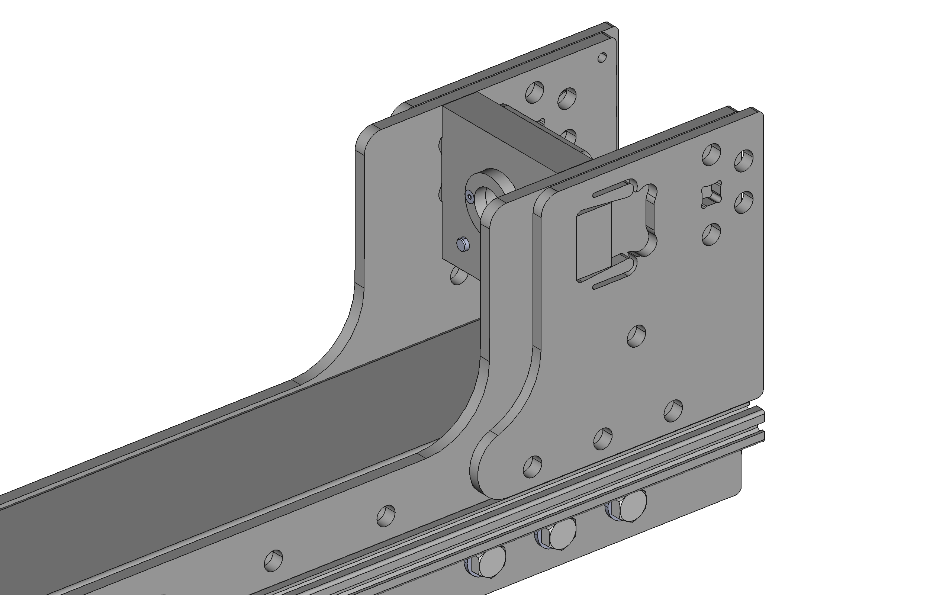
Drive opposing plates into position with a hammer (ensure steel shims remain in place)

Slide 5
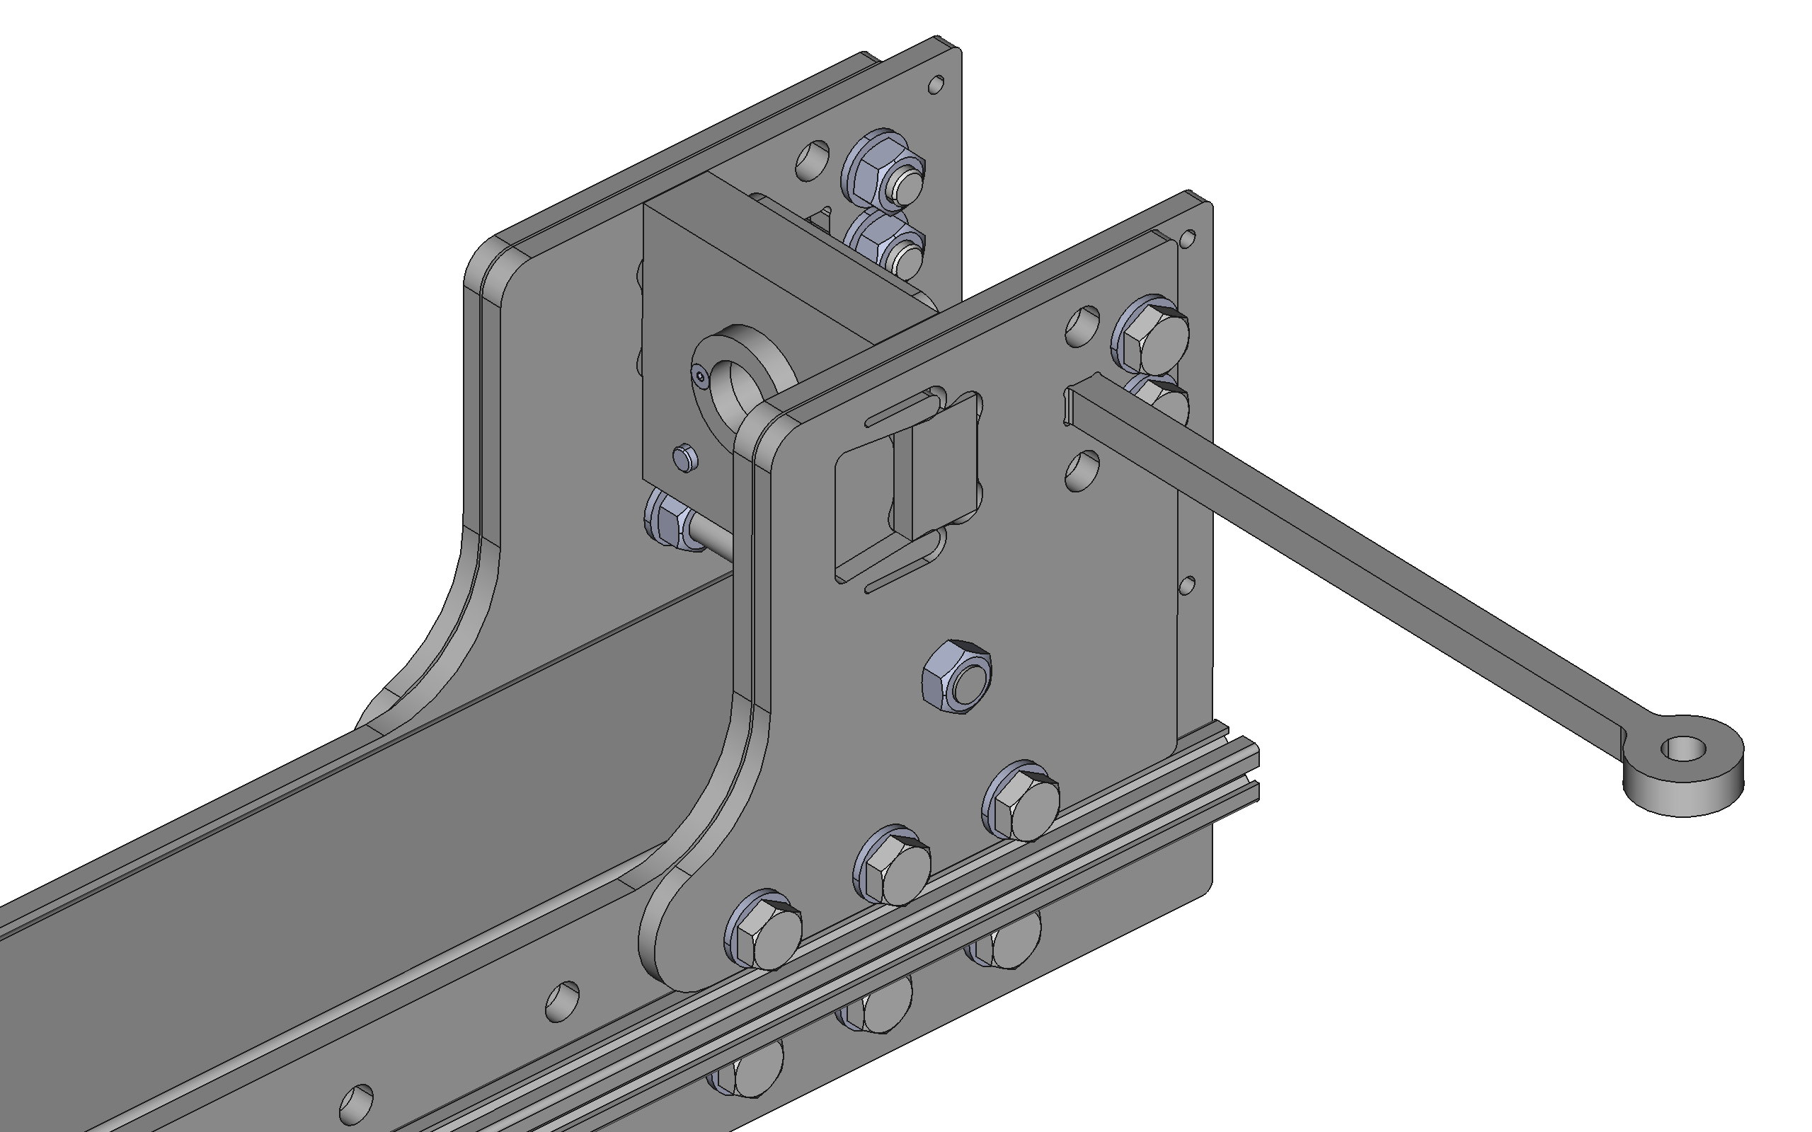
2. Determine and insert steel shims to permit proper trapping of tabbed end plate
3. Trap by tightening end nuts of installed stud
4. Use the “installation preload tool” to force opposing plate against tabbed end plate whilst initially tightening bolts, repeat for both plates
1. Loosely install additional bolts and stud for this step

Slide 6
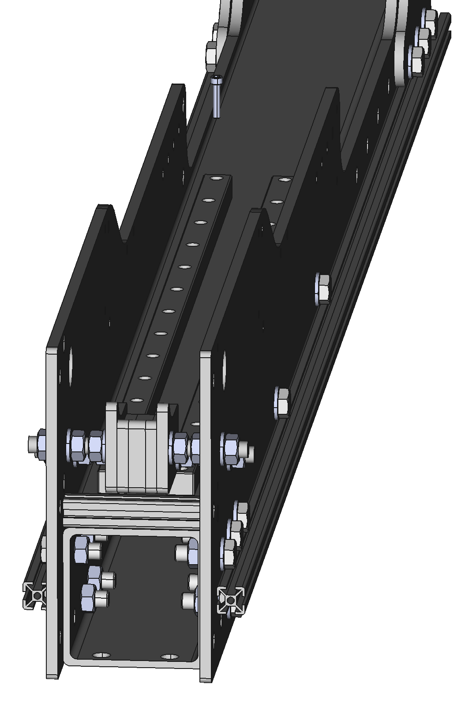
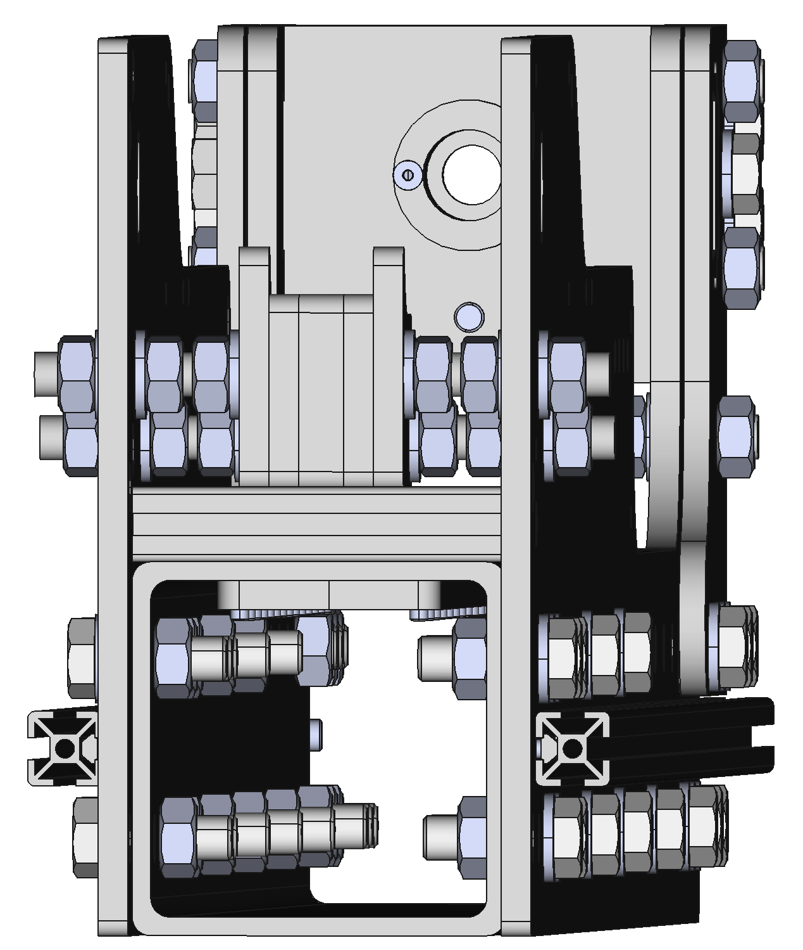
Mount rails with 28x M5x25mm cap head screw
Tapped plate

Slide 7
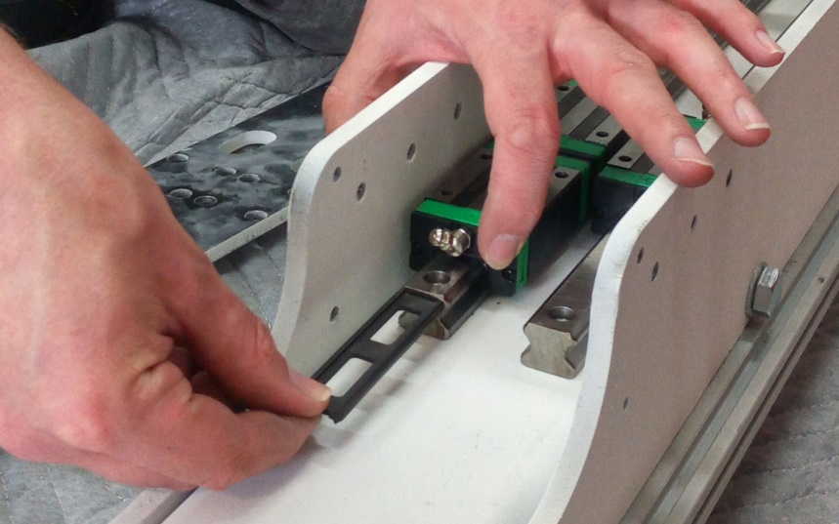
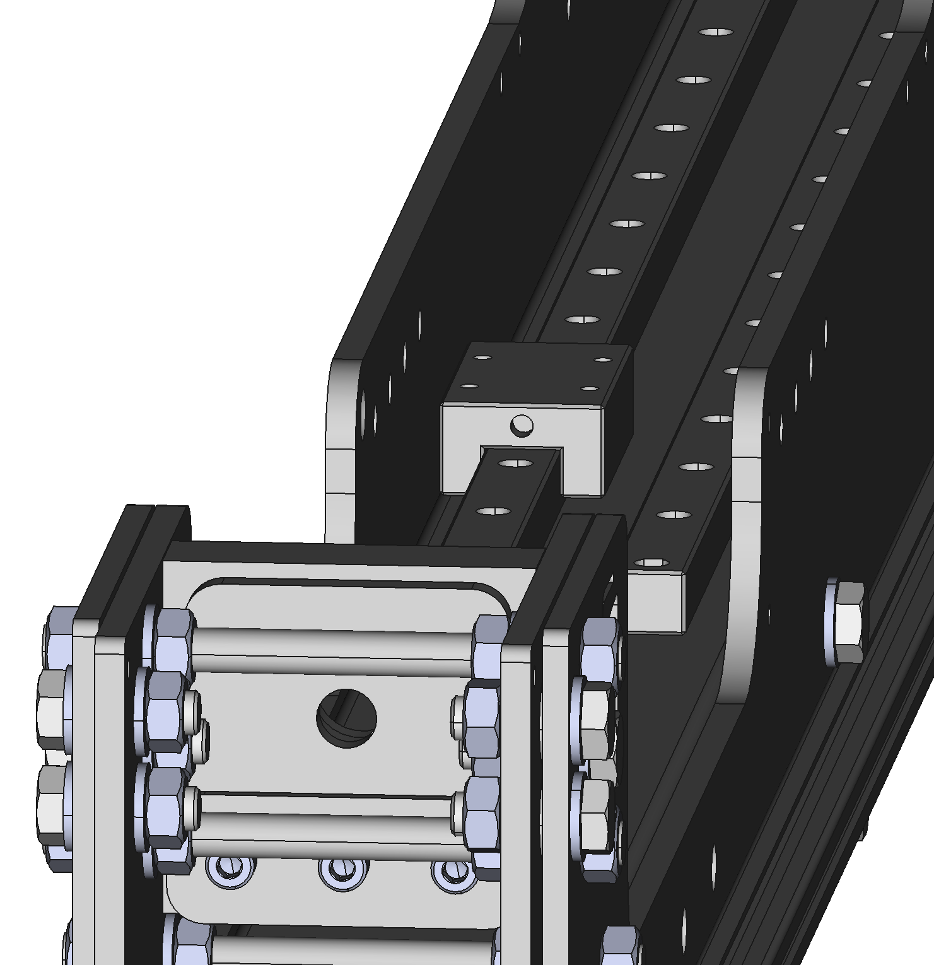
Detail of setting first rail parallel to instrument frame using a dial test indicator
Detail of setting second rail parallel to first rail using a dial test indicator
Slide ball bearing carriage from insert onto rail

